Slide 1
Enhancement of OCR service provided by Google Cloud Vision API Project
Student Name: Mohammed Mahmoud Elhmadany
ID: 2301679
Subject: Advanced Image Processing (CSE681)
Report Submitted to: Dr. Hazem Abbas

Slide 2
Complex OCR Scenario with Multi-Columns Page Handling

Slide 3
Problem description
The primary research problem is the limitation of Google Cloud Vision API in handling complex OCR scenarios. Specifically, the current OCR functionality struggles with accurately extracting text from documents with multi-column layouts, pages containing intricate tables These challenges significantly impact the quality of the extracted text, which is crucial when preparing datasets for training deep learning models and large language models (LLMs). Therefore, the aim of this project is to enhance the Google Cloud Vision API’s performance in these complex situations by applying image processing techniques.

Slide 4
1. Complex OCR Scenario with documents with multi-column layouts Handling

Slide 5
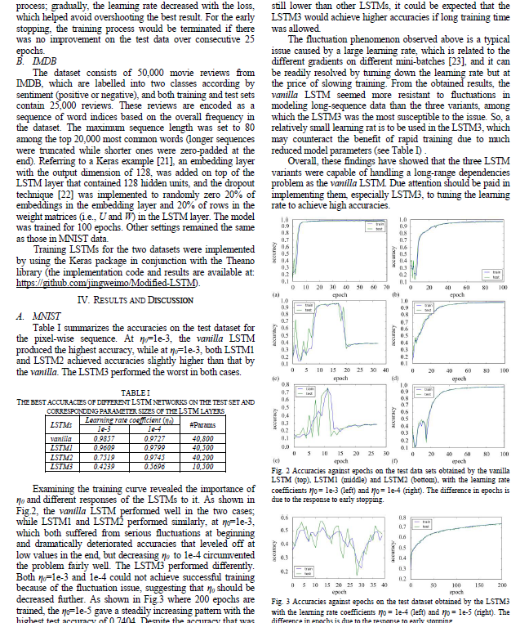
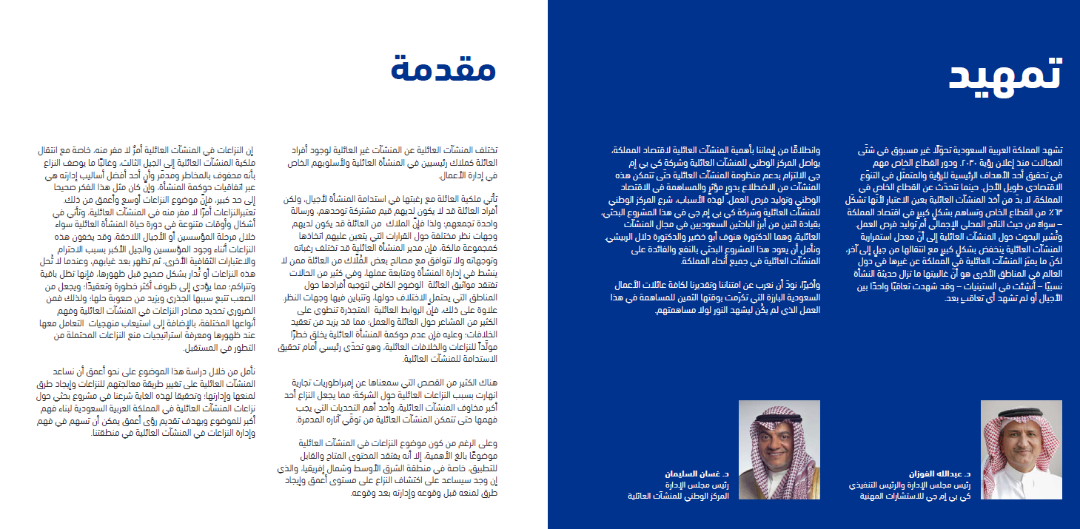
Our initial challenge in testing our solution was processing documents with multi-column layouts. One key example was the paper titled Empirical Evaluation of a New Approach to Simplifying (LSTM), as well as other examples from Arabic books containing pages with multiple columns. This paper served as our primary test case. Additionally, we applied our method to another scenario with a similar setup. Our objective is to effectively handle text from any page, regardless of the number of columns it contains.

Slide 6
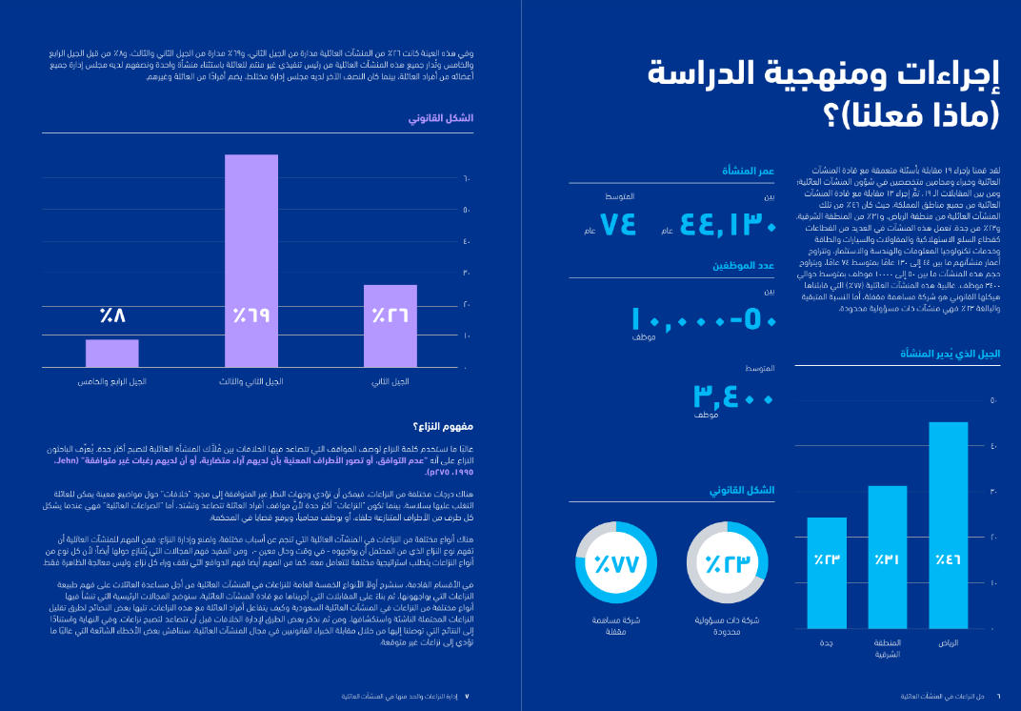
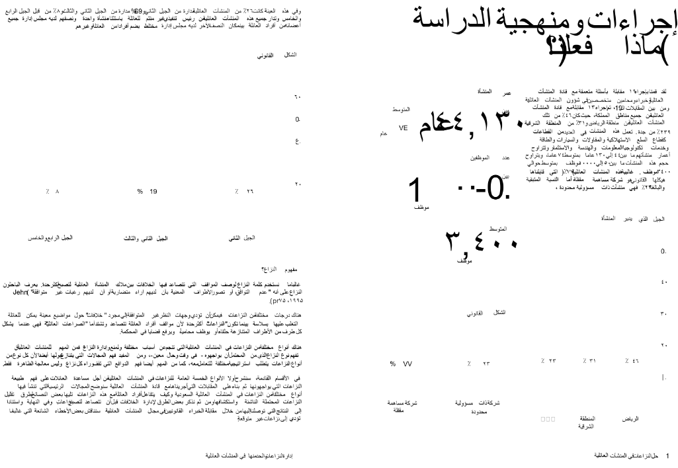
Developing a Column Detection Function for Multi-Column Text Extraction
We improved our detection method by analyzing the word positions to identify multiple text columns on pages that have varied colors and graphics.
We transferred the text onto a new blank white page of the same size to simplify the background, allowing us to handle complex page layouts effectively.

Slide 7
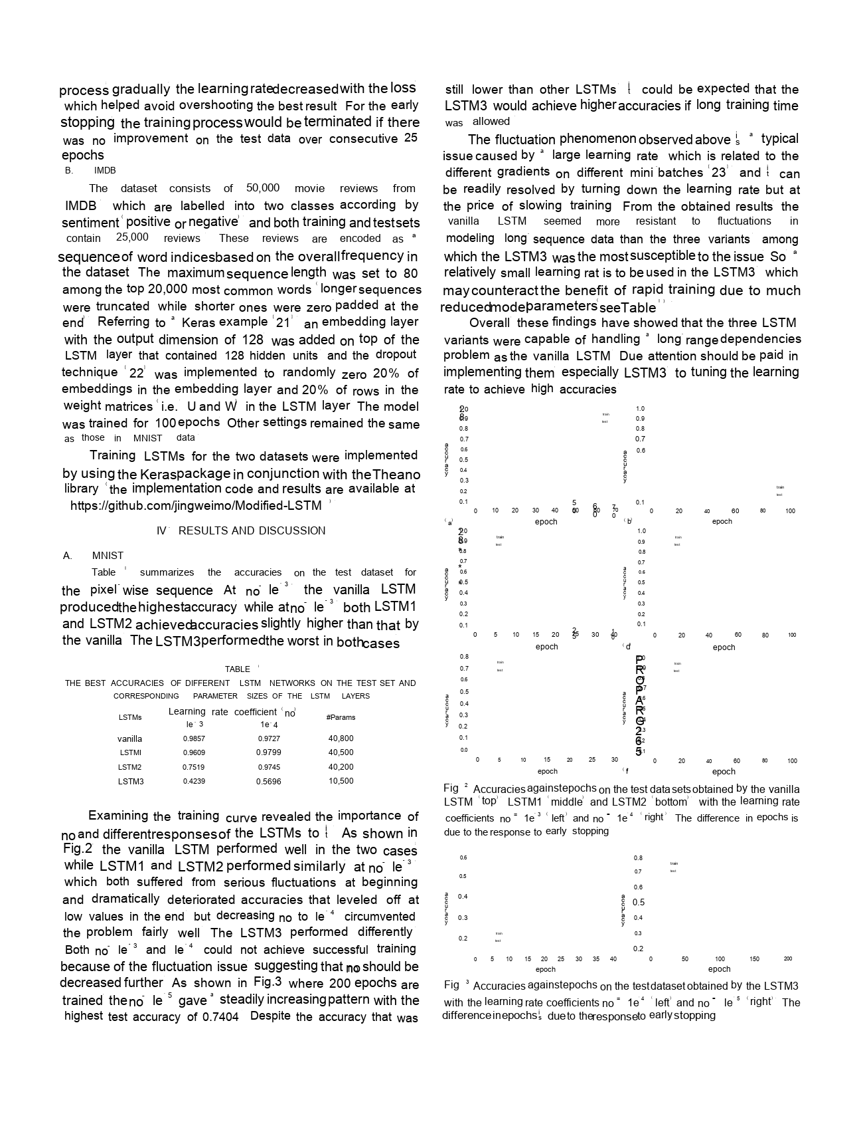
Another Example

Slide 8
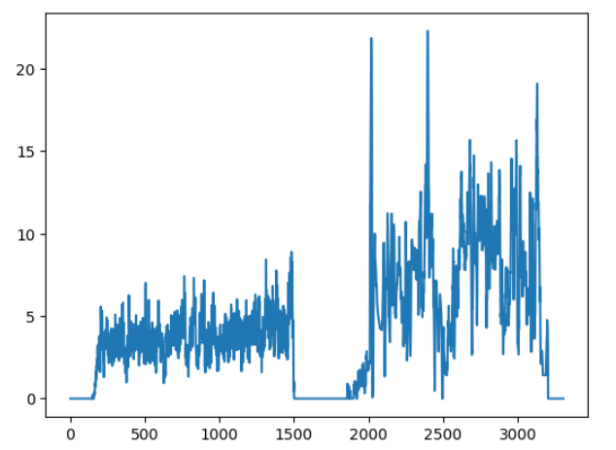
Developing a Column Detection Function for Multi-Column Text Extraction
We adjusted the font size by looking at the height of each word's bounding box, which let us enlarge just the words that are part of the title. This helped us to improve the accuracy of the extracted content.
we processed the page to fine-tune the font values after various trials. By using image projection methods, we achieved a horizontal layout of the text, which enabled us to accurately map the spread of words across the page.

Slide 9
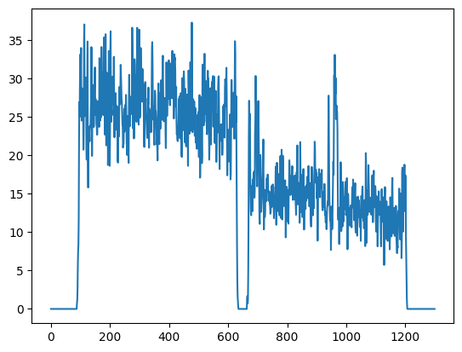
Another Example

Slide 10
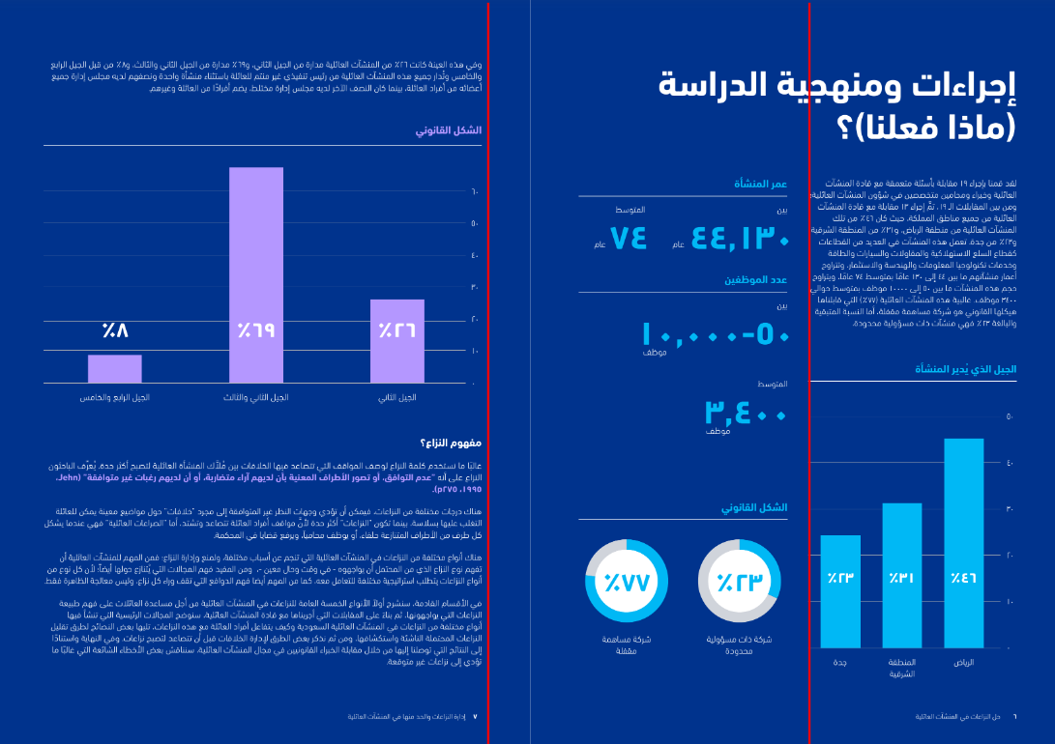
Developing a Column Detection Function for Multi-Column Text Extraction
For the final touch, we applied mathematical clustering to group and separate text. We determined that a threshold of 200 occurrences before reaching zero was optimal regard as one column, a number which we pinpointed after extensive experimentation. This helped us distinguish between different column counts effectively for various page layouts.

Slide 11
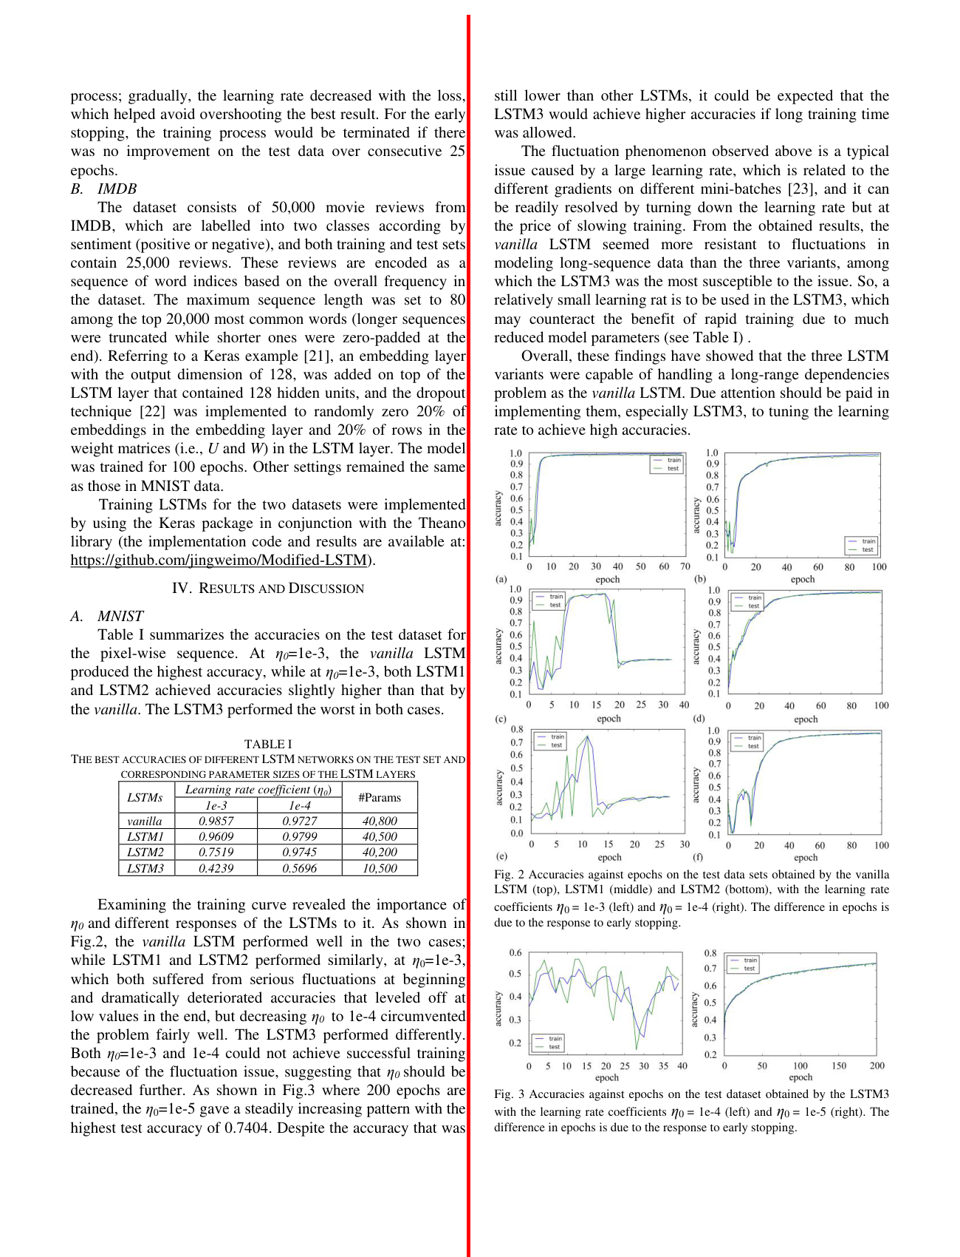
Developing a Column Detection Function for Multi-Column Text Extraction (Example)

Slide 12
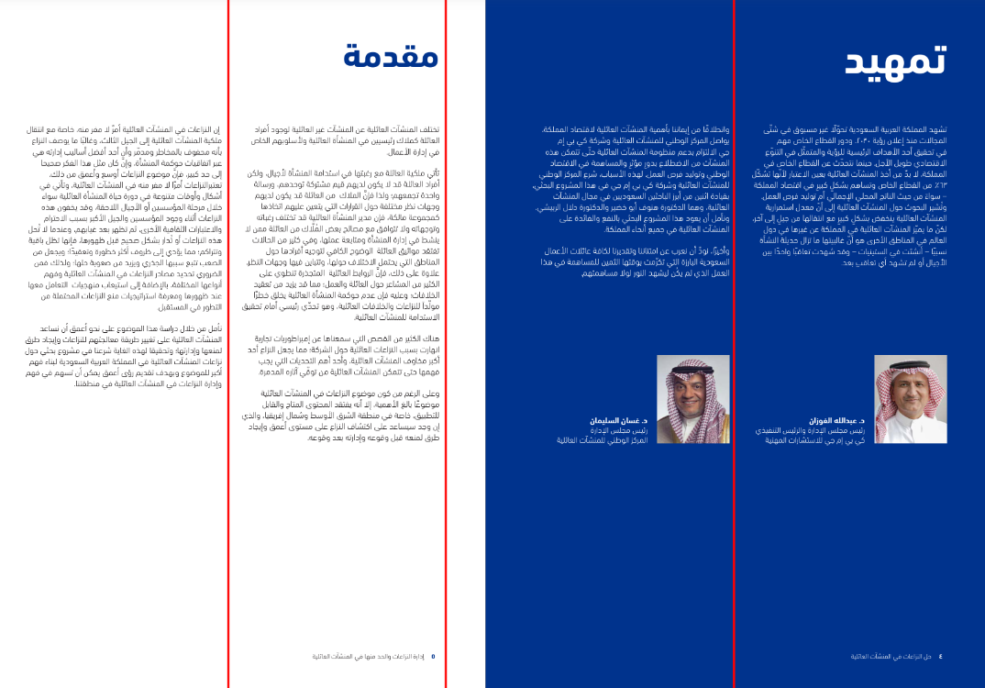
Developing a Column Detection Function for Multi-Column Text Extraction (Another Example)

Slide 13
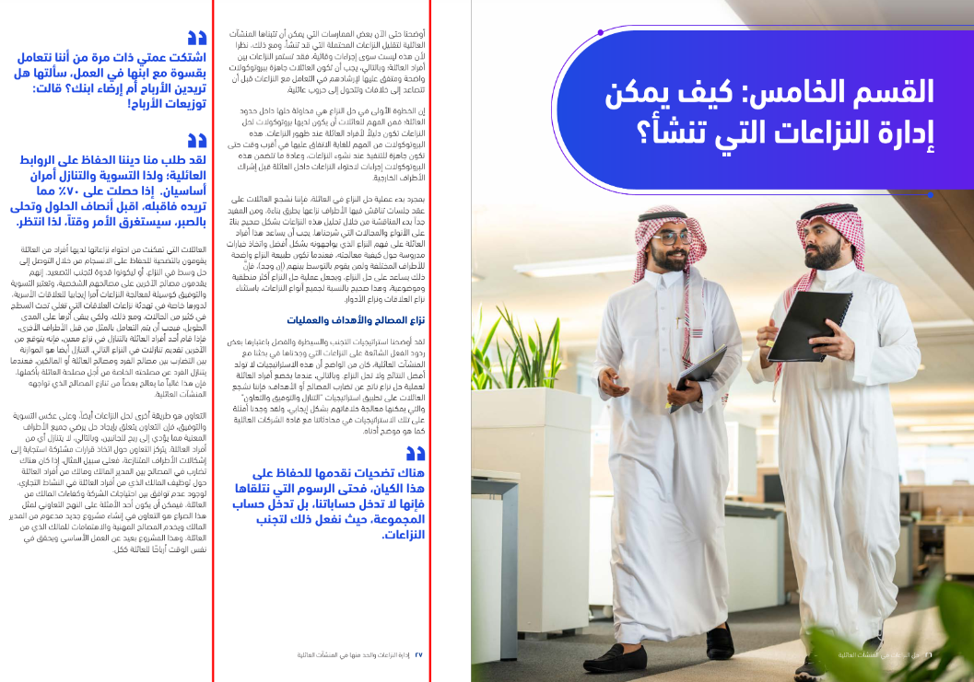
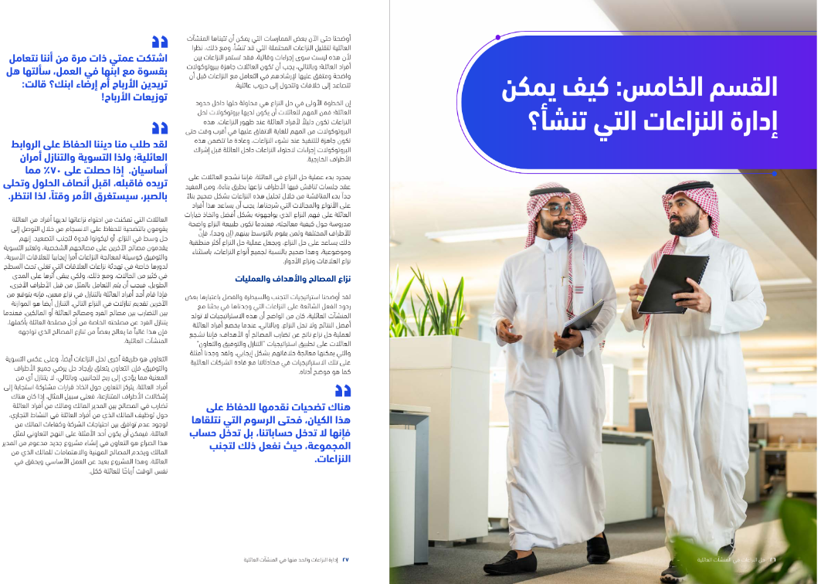
Developing a Column Detection Function for Multi-Column Text Extraction (Another Example)

Slide 14
The Arabic Extracted Text for last example
The sentence is located at the bottom of the first column on the original page.
القسم الخامس : كيف يمكن
إدارة النزاعات التي تنشأ ؟
11 حل النزاعات في المنشآت العائلية أأوضحنا حتى الآن بعض الممارسات التي يمكن أن تتبناها المنشآت
العائلية لتقليل النزاعات المحتملة التي قد تنشأ ، ومع ذلك ، نظرا
لأن هذه ليست سوى إجراءات وقائية ، فقد تستمر النزاعات بين
أفراد العائلة ؛ وبالتالي ، يجب أن تكون العائلات جاهزة ببروتوكولات
واضحة ومتفق عليها لإرشادهم في التعامل مع النزاعات قبل أن
تتصاعد إلى خلافات وتتحول إلى حروب عائلية .
إن الخطوة الأولى في حل النزاع هي محاولة حلها داخل حدود
العائلة ؛ فمن المهم للعائلات أن يكون لديها بروتوكولات لحل
النزاعات تكون دليلاً لأفراد العائلة عند ظهور النزاعات . هذه
البروتوكولات من المهم للغاية الاتفاق عليها في أقرب وقت حتى
تكون جاهزة للتنفيذ عند نشوء النزاعات ، وعادة ما تتضمن هذه
لبروتوكولات إجراءات لاحتواء النزاعات داخل العائلة قبل إشراك
الأطراف الخارجية .
بمجرد بدء عملية حل النزاع في العائلة ، فإننا نشجع العائلات على
عقد جلسات تناقش فيها الأطراف نزاعها بطرق بناءة ، ومن المفيد
جدا بدء المناقشة من خلال تحليل هذه النزاعات بشكل صحيح بناء
على الأنواع والمجالات التي شرحناها . يجب أن يساعد هذا أفراد
العائلة على فهم النزاع الذي يواجهونه بشكل أفضل واتخاذ خيارات
مدروسة حول كيفية معالجته ، فعندما تكون طبيعة النزاع واضحة
للأطراف المختلفة ولمن يقوم بالتوسط بينهم ( إن وجد ) ، فإن
ذلك يساعد على حل النزاع ، ويجعل عملية حل النزاع أكثر منطقية
وموضوعية ، وهذا صحيح بالنسبة لجميع أنواع النزاعات ، باستثناء
نزاع العلاقات ونزاع الأدوار .
--------------------- الي اخر النص

Slide 15
Our workflow summary
Read the both a PDF book file &
JSON file with word coordinates.
Transferred the text onto a new blank white page
Adjusted the font size for each word in text
Applying image projection method
Using mathematical clustering to categorize and distinguish text arranged in individual columns.
Send our pdf file to Vision API to create Json word coordinates
Extracting Text Words from each column as arranged as one paragraph text

Slide 16
2. Complex OCR Scenario with tables Page Handling

Slide 17
Problem description
We have successfully overcome the challenges of extracting textual data from tables within document images and PDF books. Our approach begins by detecting whether a table exists on the image page. If a table is present, We have implemented image processing algorithms to identify both horizontal and vertical lines within the image.. We then create a list of horizontal lines, sorting them from top to bottom based on their y-values. For each pair of adjacent horizontal lines, we check for the presence of vertical lines between them. If vertical lines are found, we determine their x-values and calculate their lengths by subtracting the y-values of the top from the bottom (y2 - y1). If a vertical line is situated between two horizontal lines, we use it to segment the text, mapping the coordinates of each word's bounding box. We repeat these steps until all horizontal lines have been processed, treating each detected vertical line as a column (marked with the symbol ‖) and each horizontal line as a row (marked with the symbol --). The resulting text layout is then compared to the output from Google Vision API for OCR before applying our approach.

Slide 18
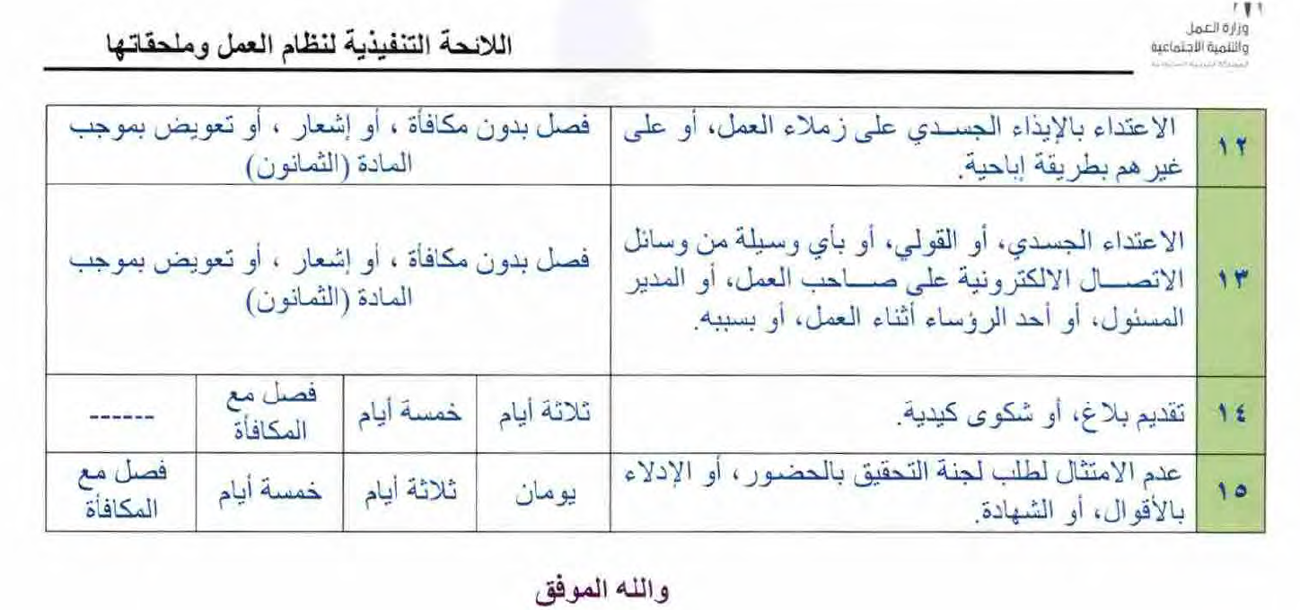
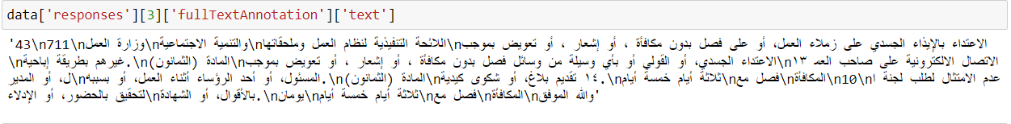
Problem description
Here, I will add some results obtained The following is the output text data from Google Vision API before applying our approach to this table.

Slide 19
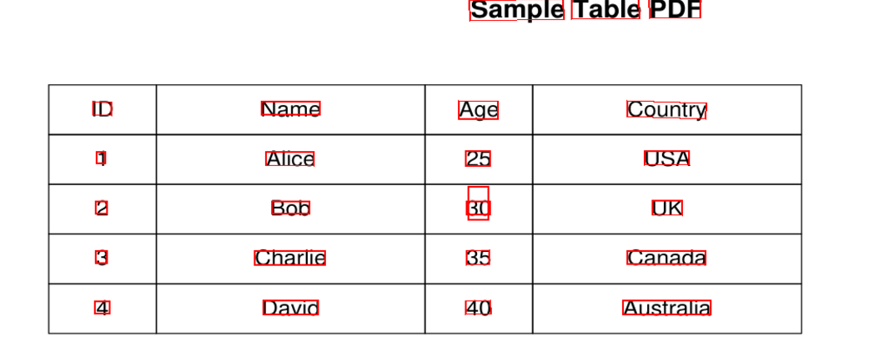
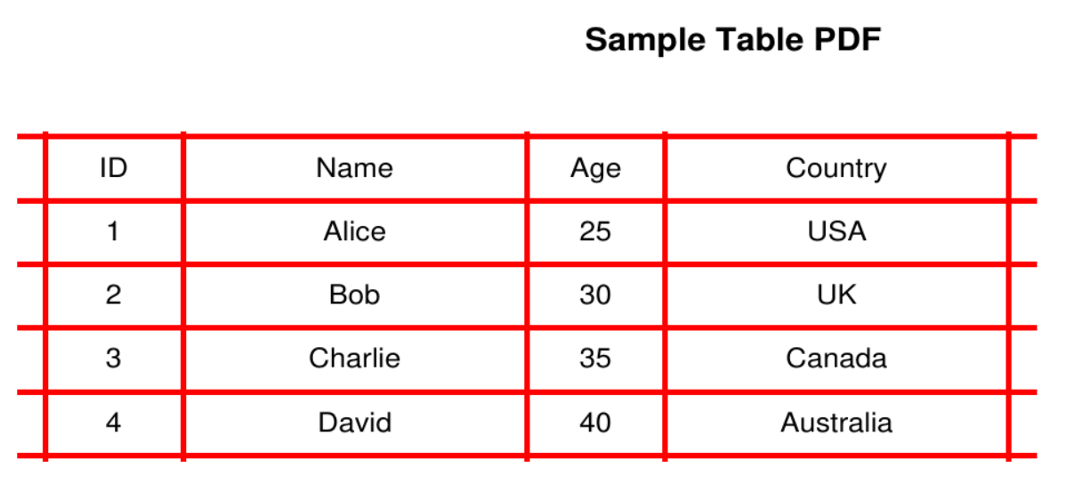
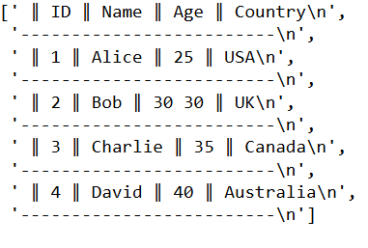
Here, After applying Our Approach After detecting the horizontal and vertical lines of the table and the output text

Slide 20
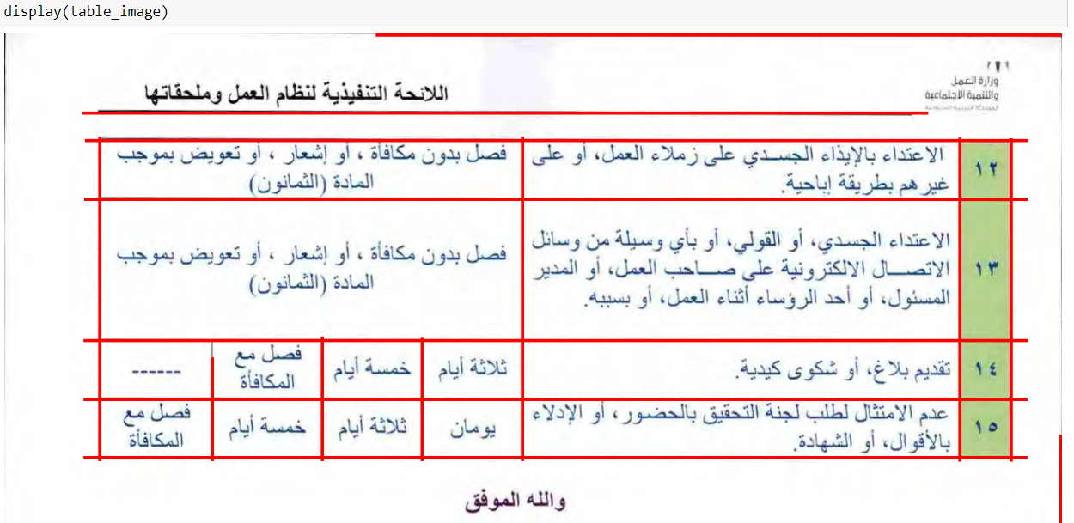
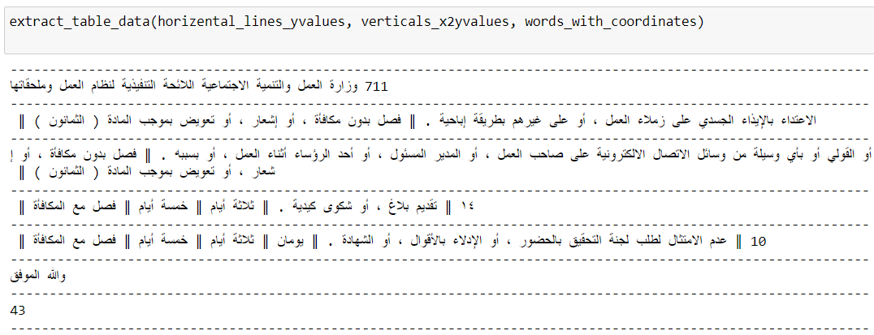
Another Example, After applying Our Approach After detecting the horizontal and vertical lines of the table and the output text

Slide 21
Thank you!

